Slide 1
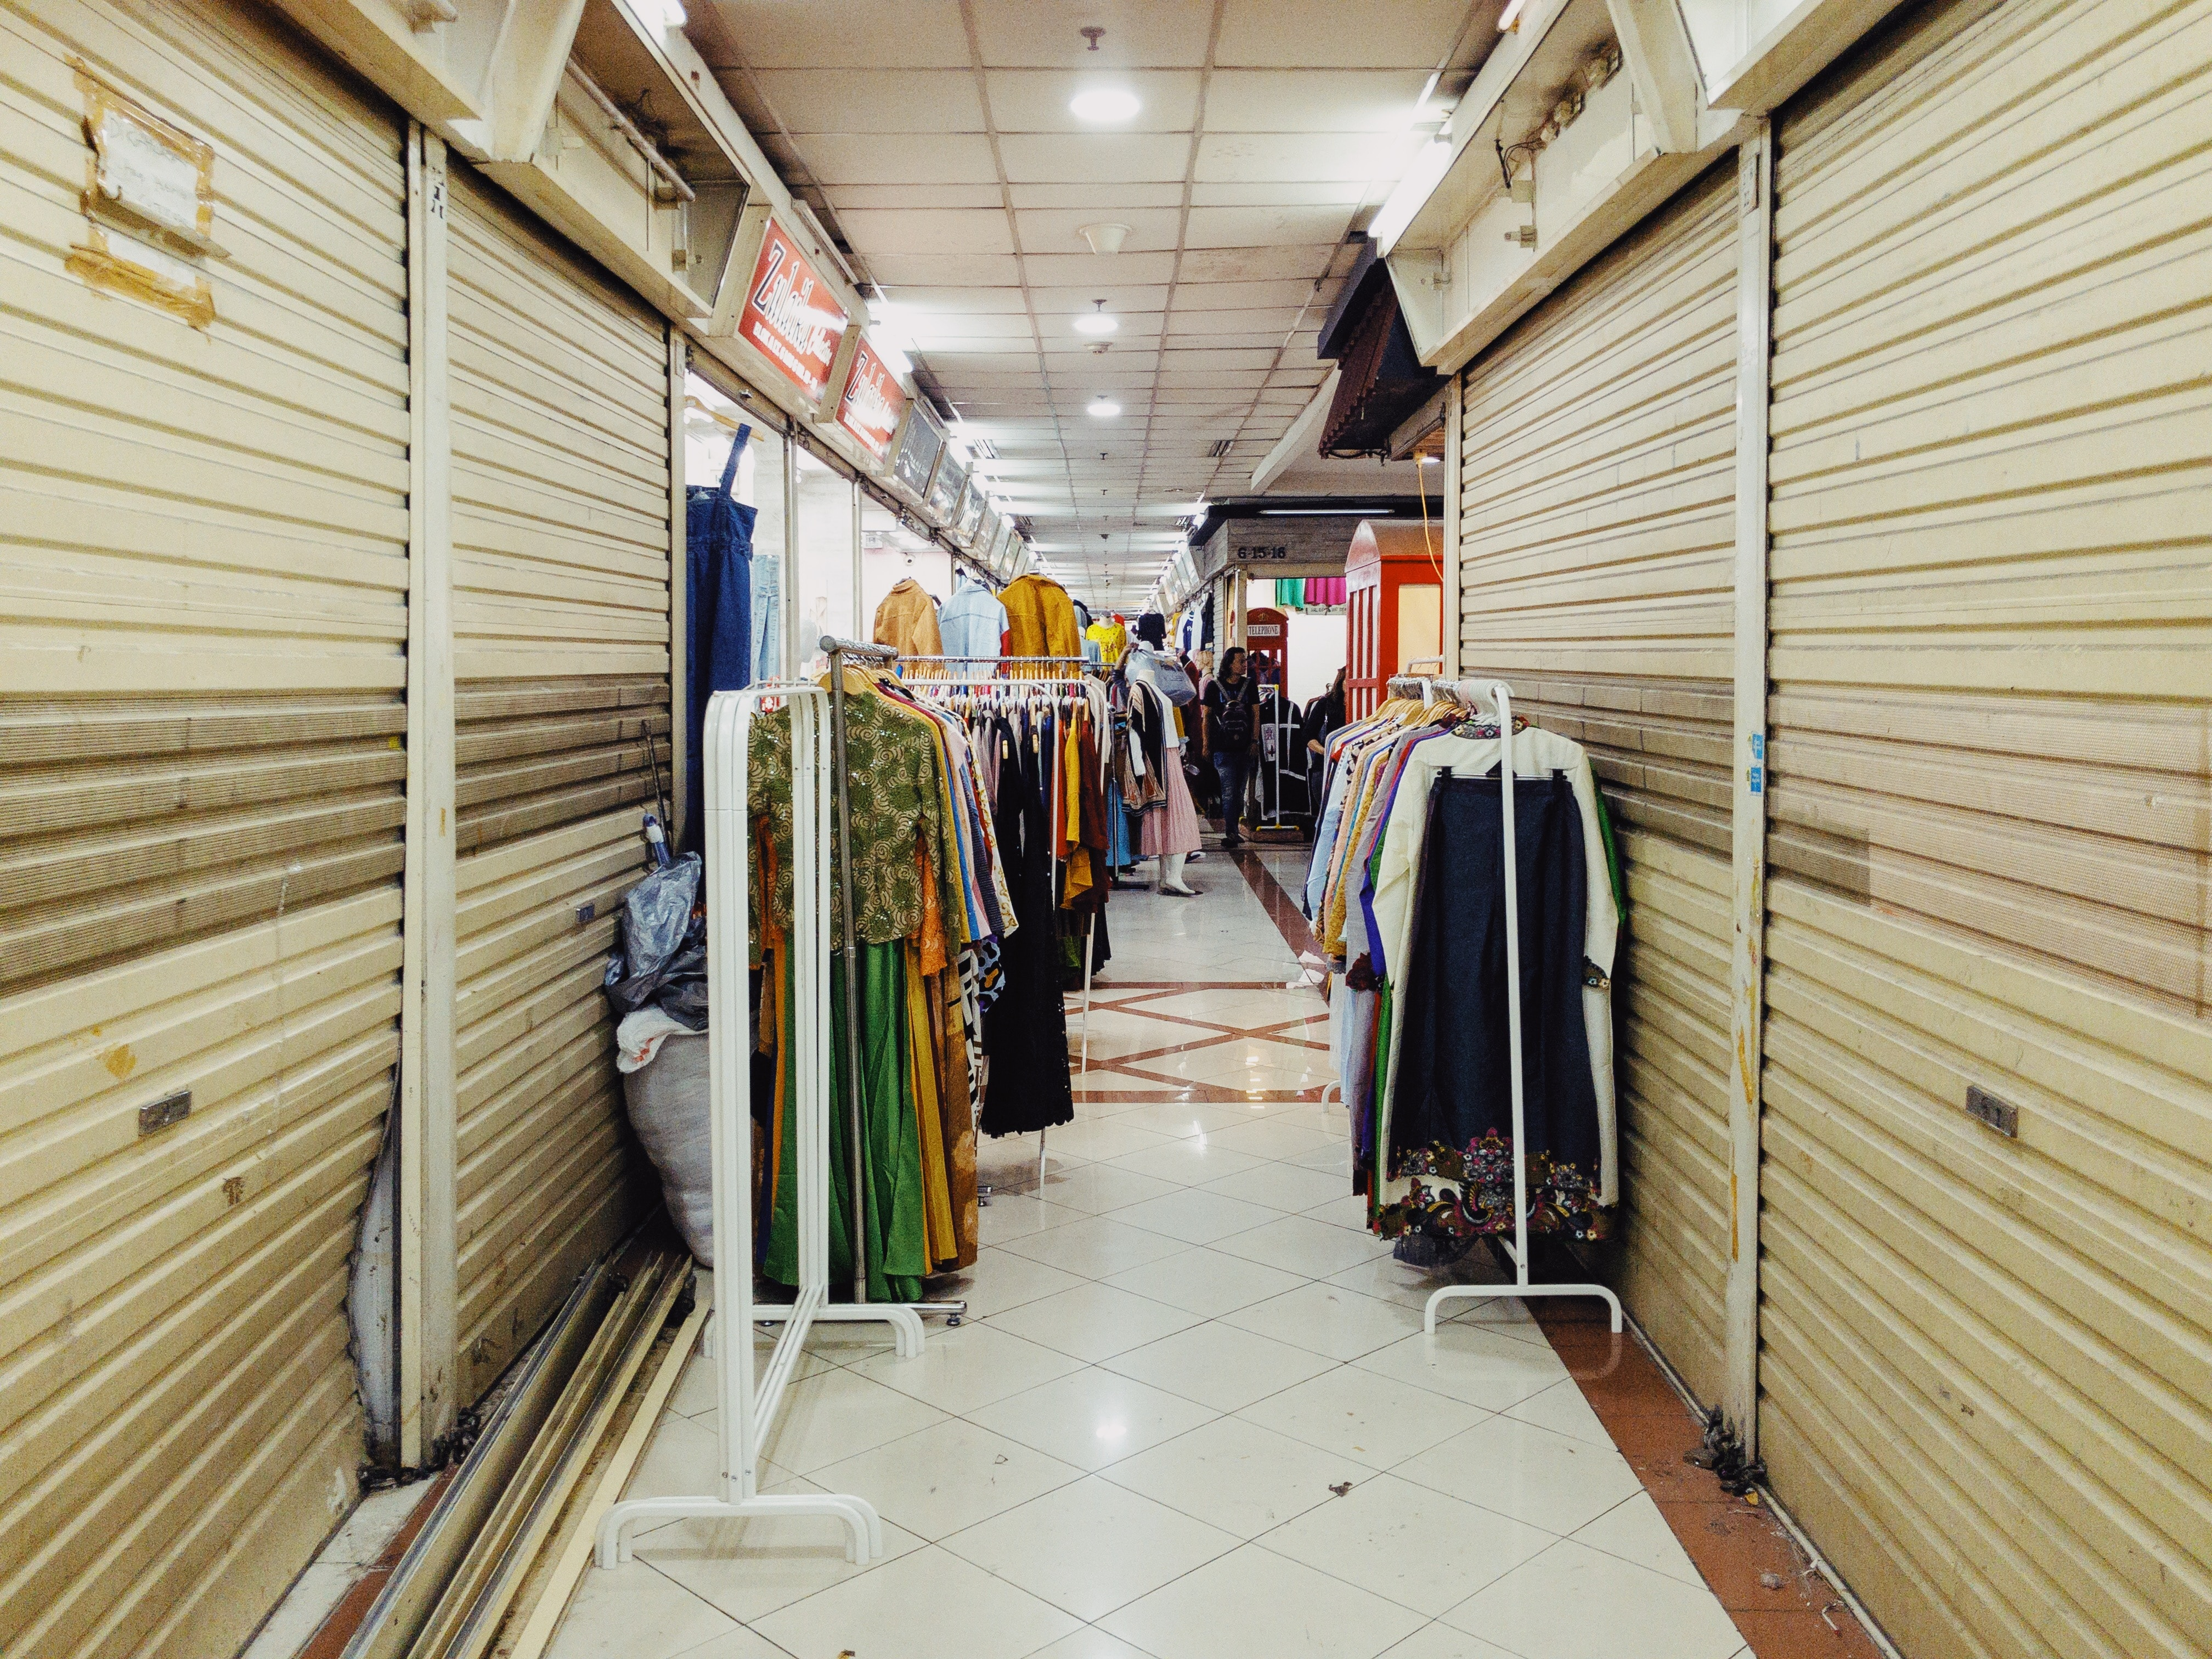
MANUFACTURING
GROUP 6
Notes:
Photo by Andhika Y. Wiguna on Unsplash

Slide 2


GROUP 6
SHIVA KUMAR
ROHIT TOSKAR
SACHIN SHETTY
RAJESH
SIDDHANT

Slide 3




INDEX
OBJECTIVE
KPI’S
VISUALIZATIONS
KEY TAKEAWAYS

Slide 4

OBJECTIVE
BOOSTING QUALITY ASSURANCE
Recognize Trends : Identify patterns to detect quality issues early.
Corrective Measures : Implement actions promptly to prevent wastage.
Continuous Monitoring : Quickly address deviations from quality standards.
Evaluate Data : Analyze machine data to foresee maintenance needs.
Plan Proactively : Schedule maintenance to minimize downtime.
Prolong Lifespan : Prevent major breakdowns and extend equipment life.
Streamline Production : Improve resource utilization.
Boost Productivity : Increase efficiency and reduce costs.
PREDICTIVE UPKEEP
ENHANCING OPERATIONAL EFFEINCEY

Slide 5
KPI’S
MANUFACTURING QUANTITY
REJECTED QUANTITY
PROCESSED QUANTITY
WASTAGE QUANTITY
EMPLOYEE WISE REJECTED QUANTITY
MACHINE WISE REJECTED QUANTITY
PRODUCTION COMPARISON TREND
MANUFACTURED VS REJECTED QTY
DEPARTMENT WISE REJECTED QTY
10. EMP WISE REJECTED QTY

Slide 6
KPI’S

Slide 7
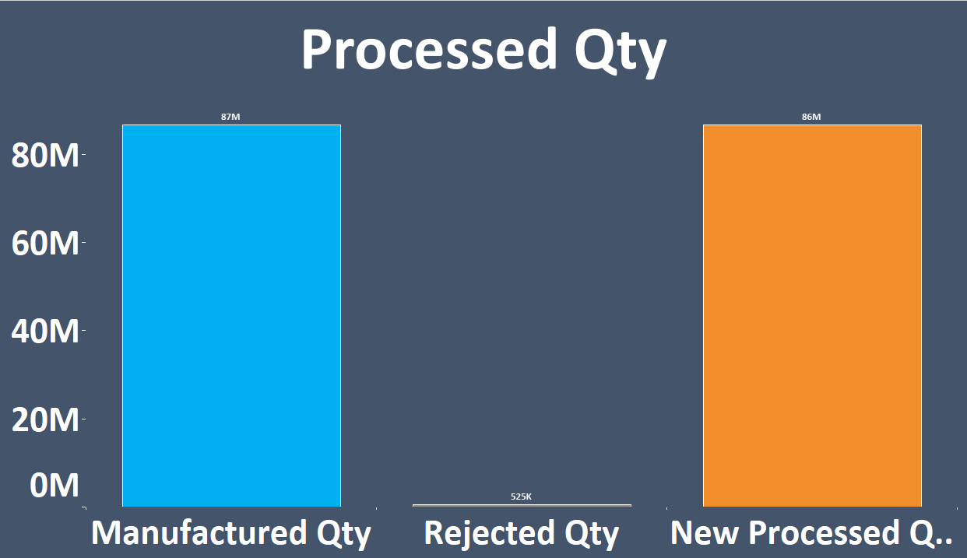
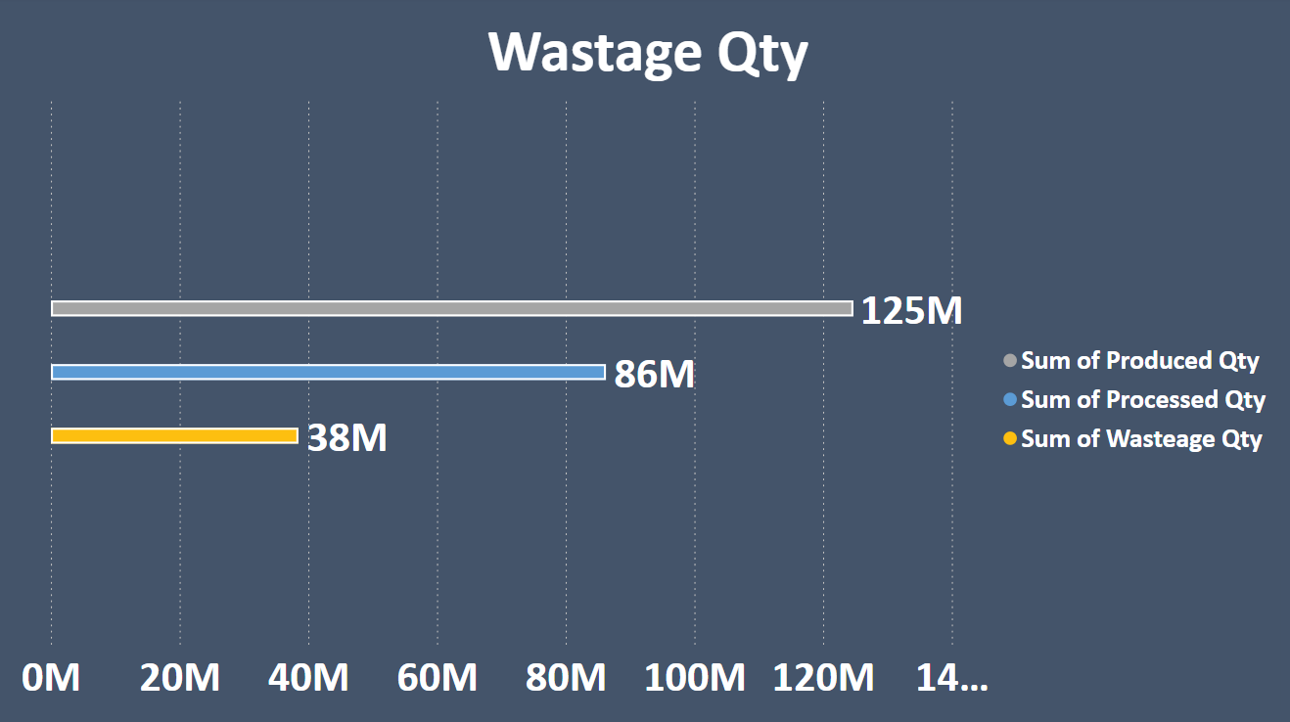

KPI’S
87M
86M
525k
Manufactured Qty
Rejected Qty
Processed Qty

Slide 8
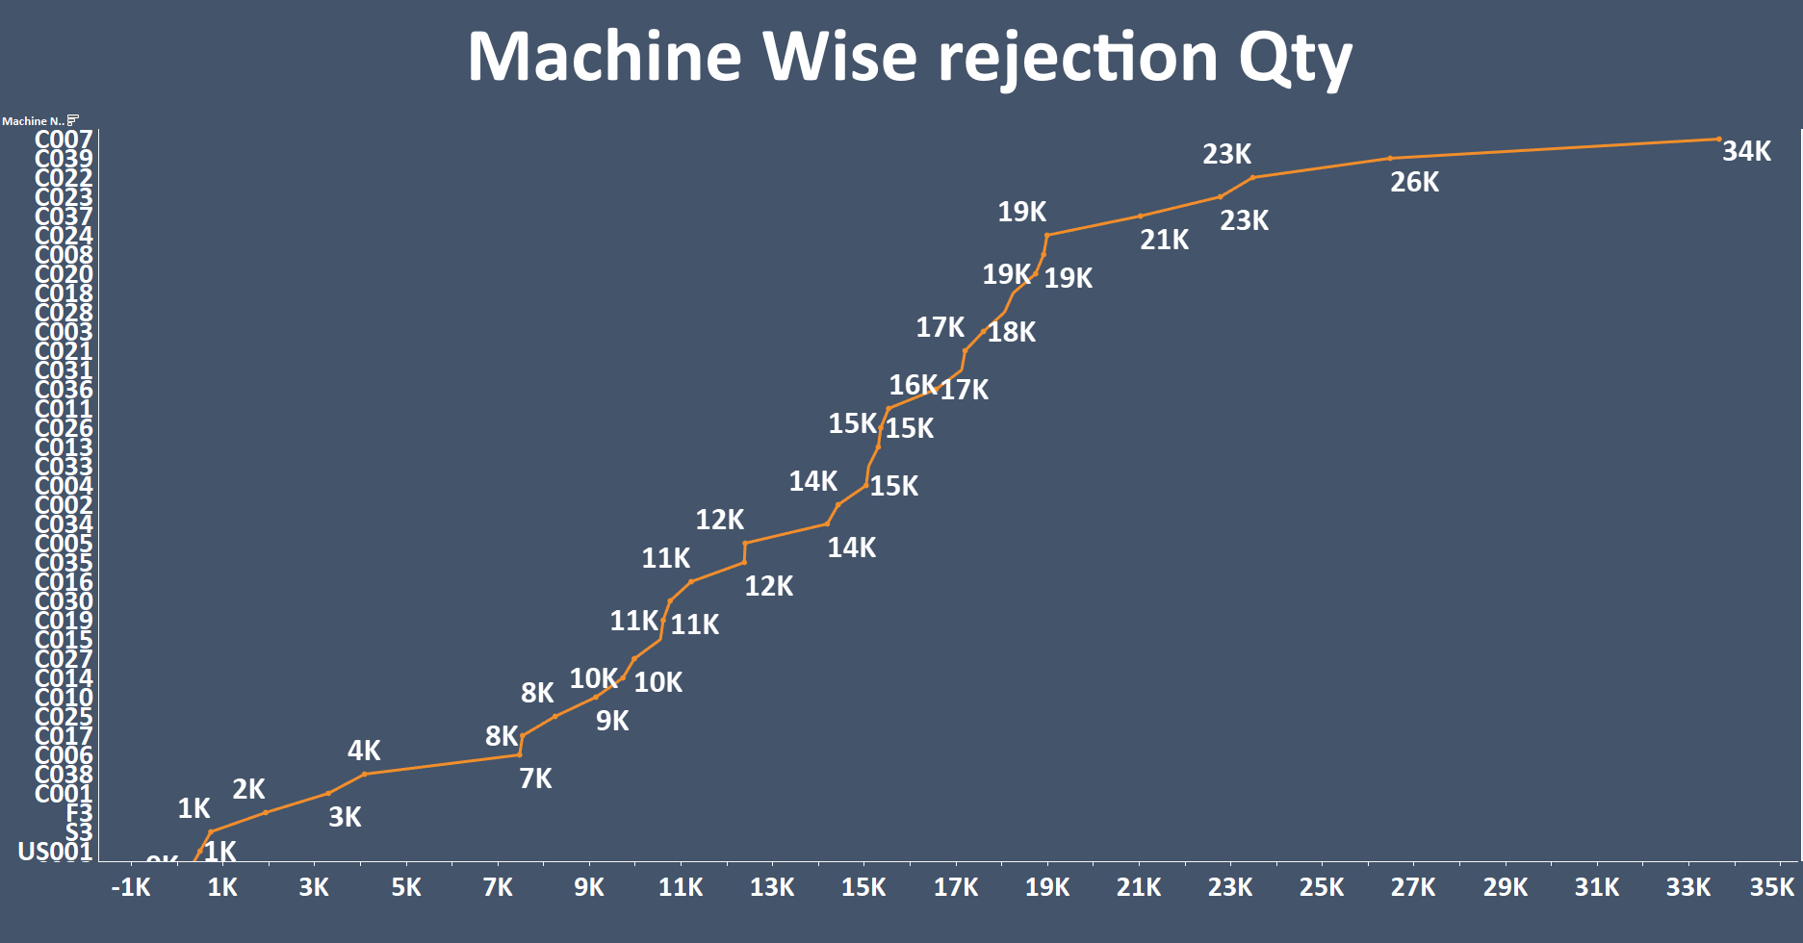
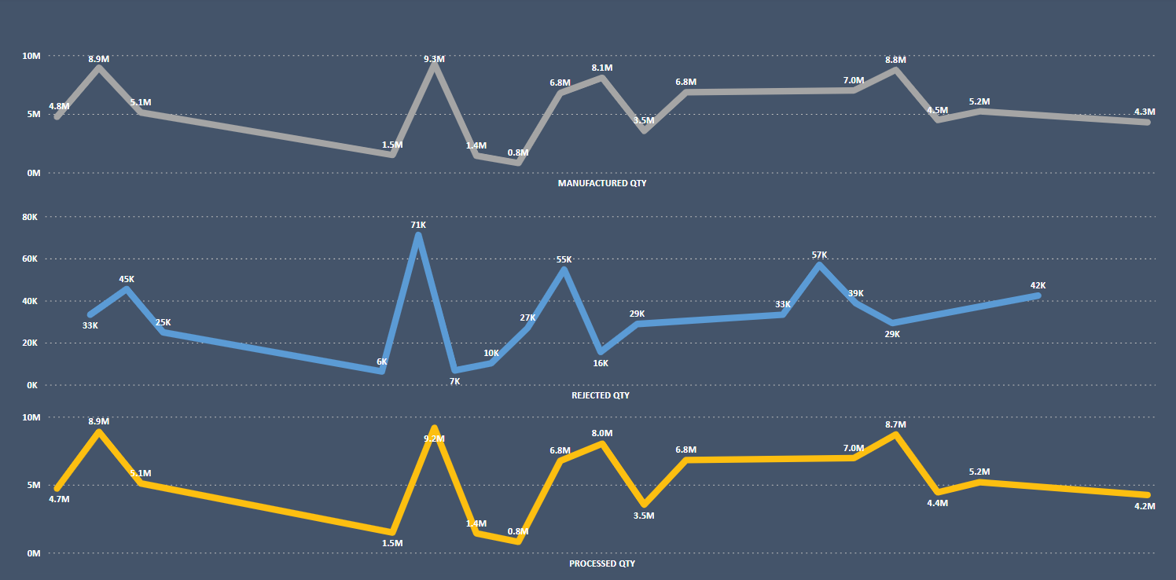
KPI’S
Production comparison trend

Slide 9
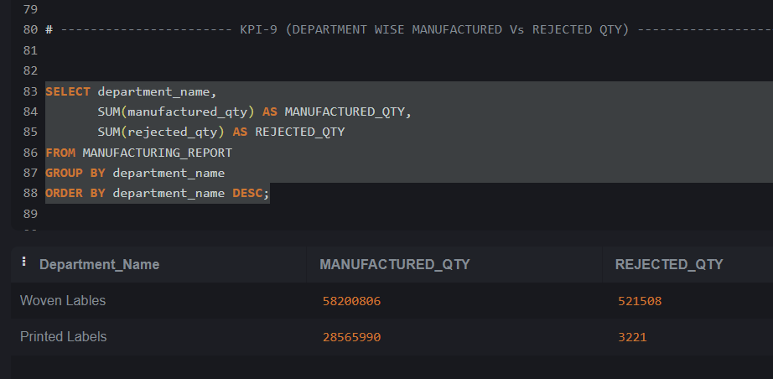
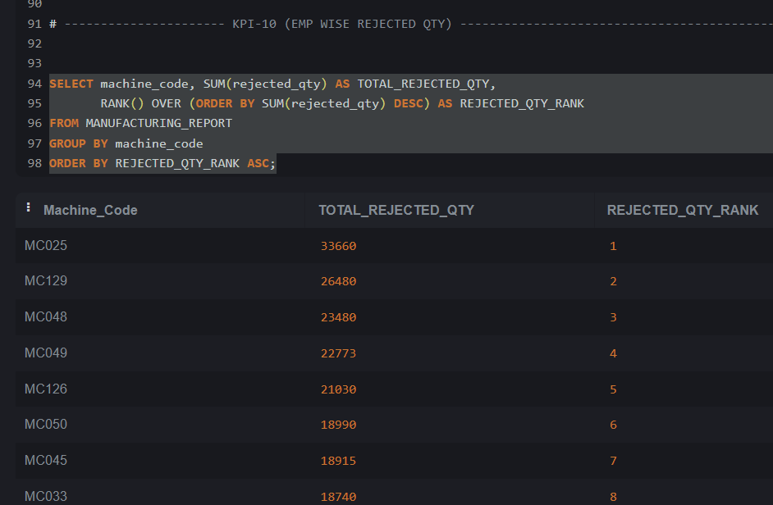
KPI’S

Slide 10
KEY TAKEAWAYS
KEY TAKEAWAYS
HIGH OVERALL PRODUCTION : A TOTAL MANUFACTURED QUANTITY OF APPROXIMATELY 8.06 MILLION UNITS TRANSLATES TO A SUCCESS RATE OF AROUND 99%. THIS INDICATES STRONG OVERALL PRODUCTION EFFICIENCY.
MINIMAL WASTAGE : THE TOTAL REJECTED QUANTITY OF AROUND 524,000 UNITS REPRESENTS ONLY ABOUT 1% OF THE MANUFACTURED QUANTITY. THIS SUGGESTS EFFECTIVE QUALITY CONTROL MEASURES ARE IN PLACE.
INDIVIDUAL PERFORMANCE VARIABILITY : SHRUTI SINGH HAD THE HIGHEST NUMBER OF REJECTS, WHILE KALI PRASAD HAD THE LOWEST. THIS HIGHLIGHTS THE POTENTIAL FOR TARGETED TRAINING OR PROCESS ADJUSTMENTS TO IMPROVE INDIVIDUAL PERFORMANCE.

Slide 11
KEY TAKEAWAYS
KEY TAKEAWAYS
MACHINE PERFORMANCE VARIATIONS : MACHINE C002 HAD THE HIGHEST NUMBER OF REJECTS, WHILE MACHINE C31 HAD THE LOWEST. INVESTIGATING THE REASONS BEHIND THIS DISPARITY COULD LEAD TO MACHINE-SPECIFIC OPTIMIZATIONS.
PRODUCTION FLUCTUATIONS : DAILY PRODUCTION QUANTITIES VARIED SIGNIFICANTLY, WITH THE HIGHEST ON NOVEMBER 10TH (925,2803) AND THE LOWEST ON NOVEMBER 12TH (802,677). UNDERSTANDING THE FACTORS INFLUENCING THESE FLUCTUATIONS CAN HELP WITH PRODUCTION PLANNING AND SCHEDULING.
DEPARTMENTAL VARIATIONS : THE PRINTED LABELS DEPARTMENT HAD A MUCH LOWER REJECTION RATE (AROUND 3,000) COMPARED TO THE WOVEN LABELS DEPARTMENT (AROUND 525,000). ANALYZING THESE DEPARTMENTAL DIFFERENCES CAN PROVIDE INSIGHTS FOR IMPROVEMENT STRATEGIES.

Slide 12
THANK YOU
Notes:
Photo by Andhika Y. Wiguna on Unsplash

